Slide 1

WAY TO ENTERPRISE
AWS
VTI ACADEMY
Author: duy.nguyenngoc1@vti.com.vn

Slide 2
Agenda
Redshift Service
Glue Service
Athena Service
QuickSight Service
Neptune Service
Elastic MapReduce Service
Lakehouse Architecture
Assignments &Quiz
Copyright © VTI Academy All Rights Reserved

Slide 3
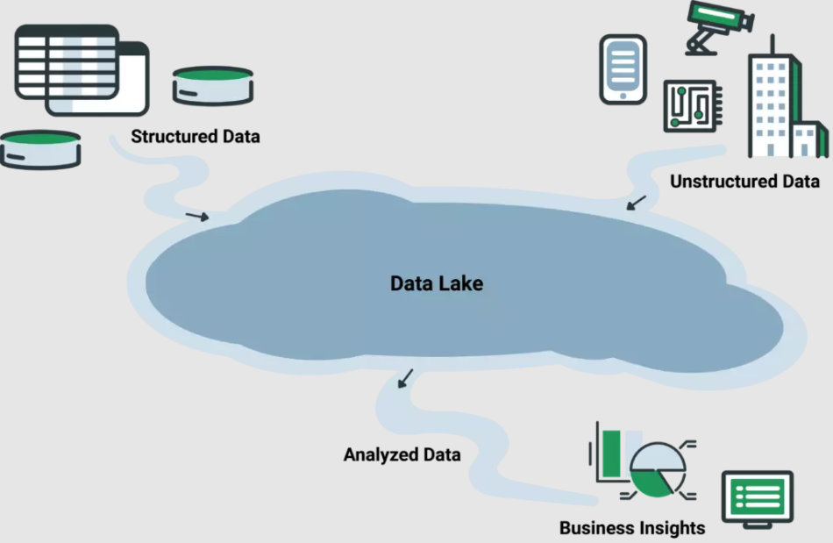
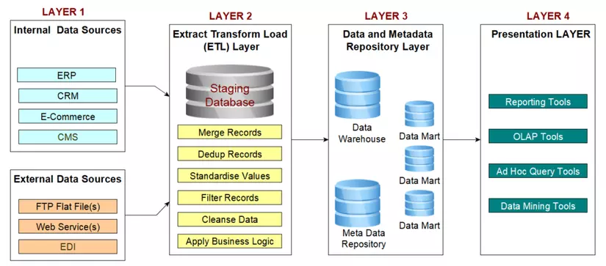
Introduction
Data Lake
  Is a extreme center data is used to store raw data that is not normalized
  The data comes from many different sources
  Usecases: store raw data, original data (several TBs or more)
Data Warehourse
  Is a center data is used to store normalized data
  The data must be ETL (Extract – Transform – Load) before saving in Data Warehourse

Slide 4
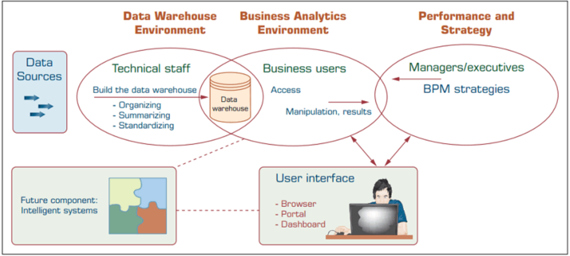
Introduction
  Usecases
    Data analysis, reporting data 🡺 run large query
    Big data, AI
  Tools: Cognos, Jaspersoft, SQL Server Reporting Services, Oracle Hyperion, SAP NetWeaver

Slide 5
Introduction
OLTP (Online Transaction Processing)
  Use in database
  Make sure the whole process becomes a transaction
  The main query structure is insert, update, delete
  Dynamic data
OLAP (Online Analytics Processing)
  Use for Data Warehouse
  The main query is an extremely select
  It takes up to a few hours, only running the query sometimes
  Static data
  Usecases: Data analysis, reporting data

Slide 6
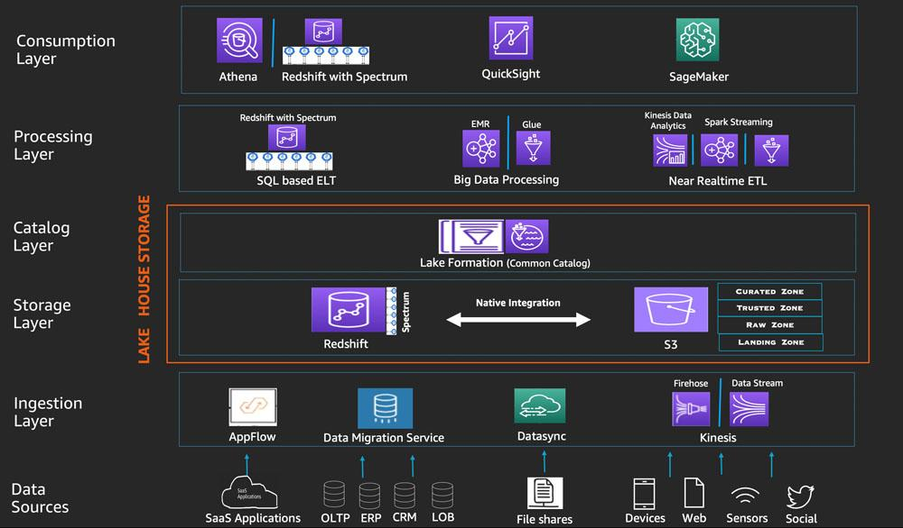
Introduction
AWS Data Lake Architecture

Slide 7
Redshift Service
Is service for Data Warehouse
Managed service, high performance, petabyte-scalable
10x better performance than other data warehouses
SQL interface for performing the queries
Regional service
Price: https://aws.amazon.com/redshift/pricing
Tutorial: https://docs.aws.amazon.com/redshift/latest/mgmt/welcome.html

Slide 8
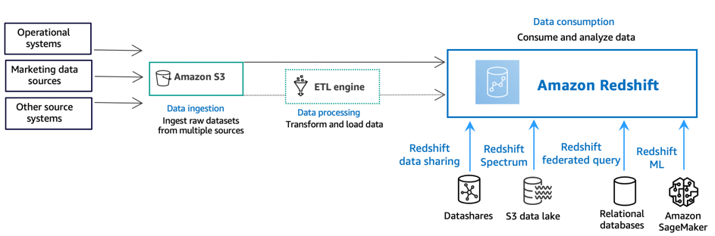
Redshift Service
Flow
  Data ingestion layer
    Raw data come from different data sources (structured, semi-structured, unstructured data)
  Data processing layer
    Raw data will be processed, validated, transform, ... using extract, transform, load pipelines (AWS Glue)

Slide 9
Redshift Service
  Data consumption layer
    Load data into Redshift cluster and handle workload
    Spectrum: query directly data from outsource (S3, ...) without loading into Redshift
    Federated Query: query RDS without loading into Redshift
    Machine learning (ML): Create model for ML from Redshift
    Data sharing: Use to share data for other accounts

Slide 10
Assignment
  Self-practice

Slide 11
Redshift Service
Demo
  Create data in S3
  Create Cluster
  Create Table in Cluster
  Load data from S3 Bucket to Redshift table
  Select Data
https://docs.aws.amazon.com/redshift/latest/gsg/new-user.html

Slide 12
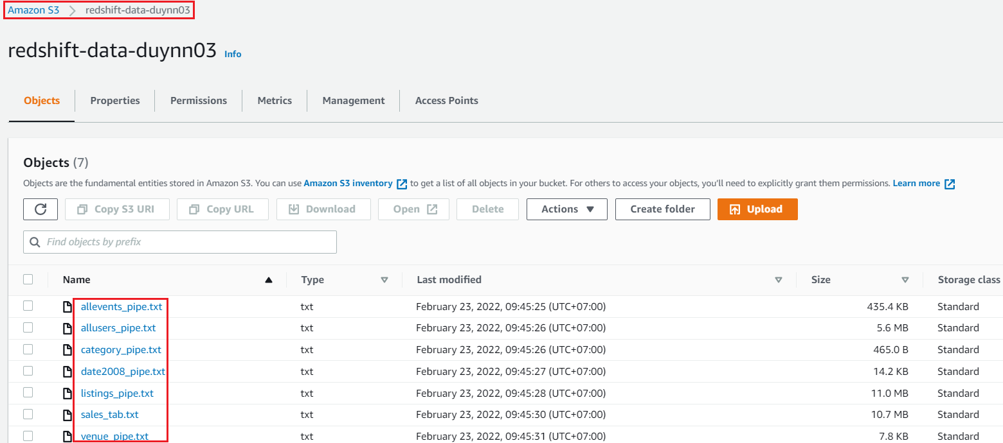
Redshift Service
  Create data in S3

Slide 13
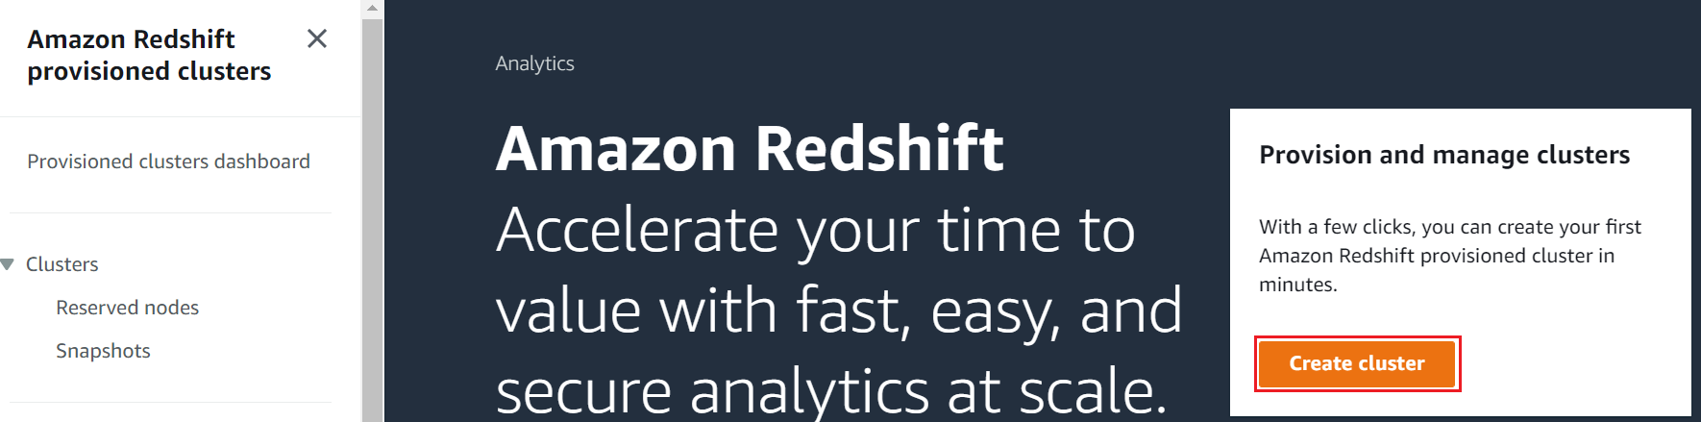
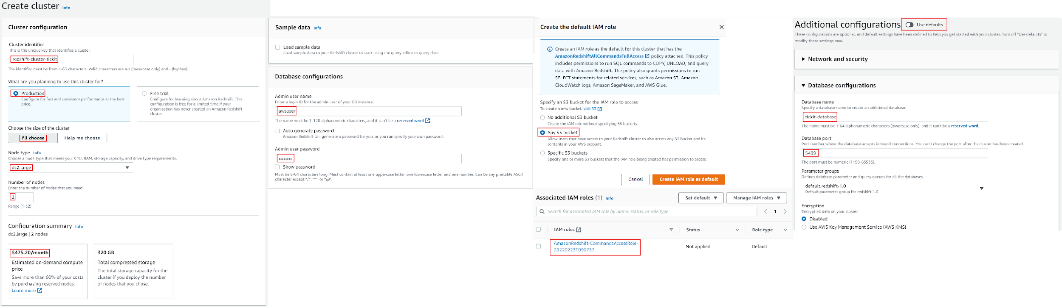
Redshift Service
  Create Cluster

Slide 14
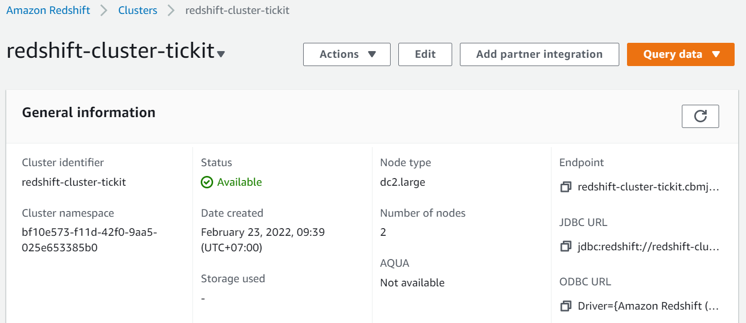
Redshift Service

Slide 15
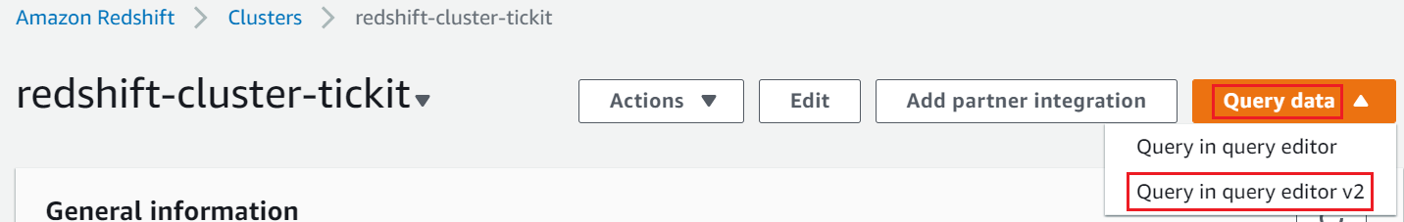
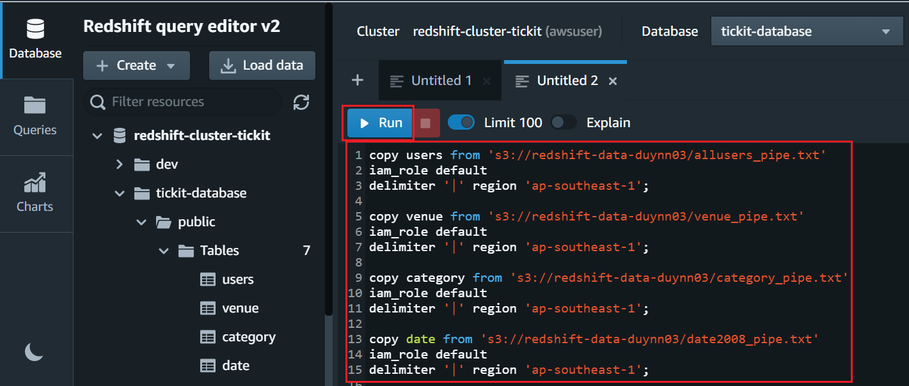
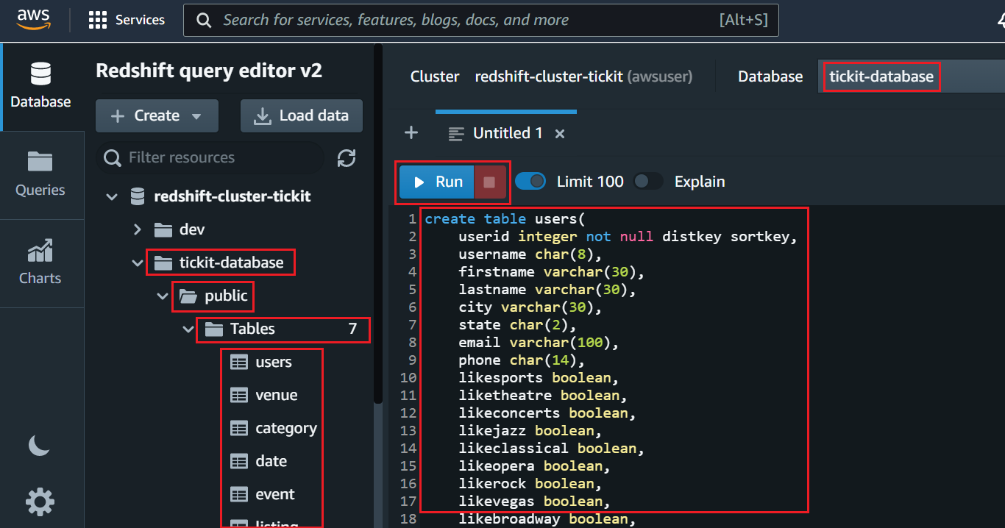
Redshift Service
  Create Table in Cluster
  Load data from S3 Bucket to Redshift table

Slide 16
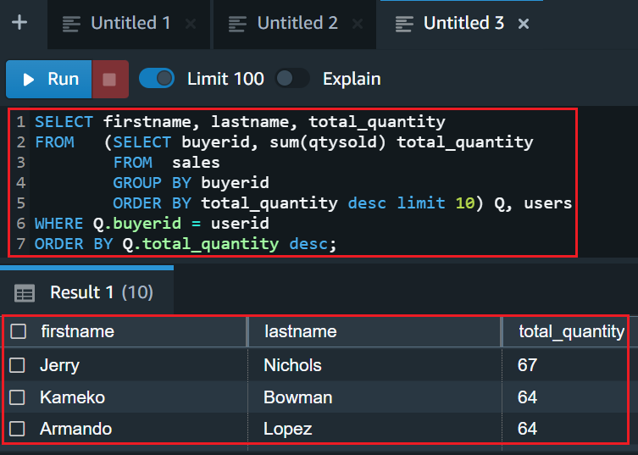
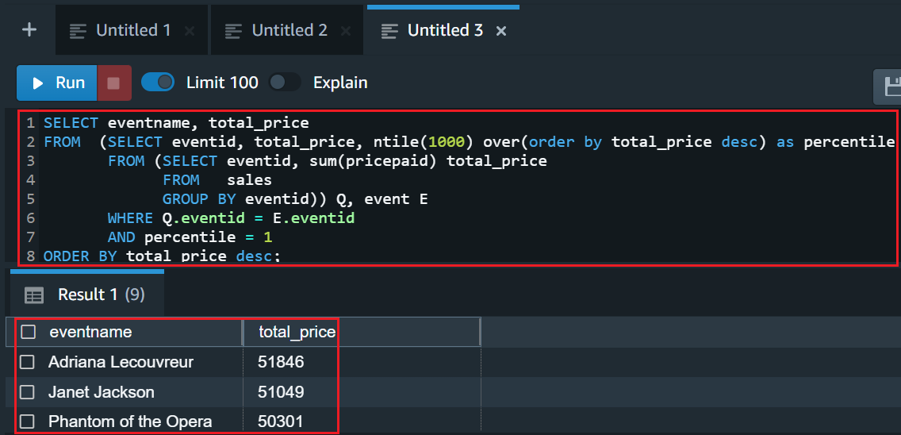
Redshift Service
  Select data

Slide 17
Redshift Service
Other demo
  Create model in Machine Learning: Link
  Federated Query to RDS: Link
  Spectrum: Link

Slide 18
Assignment
  Self-practice

Slide 19
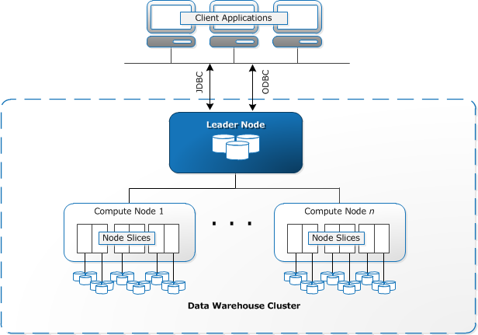
Redshift Service
Components
  Cluster
  Node
  Database
  Client Application
  Connection

Slide 20
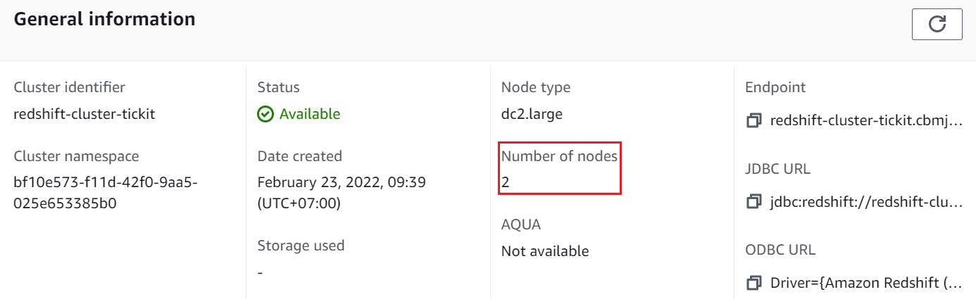
Redshift Service
  Cluster
    2 types
      Single Node: Including only 1 node
      Multi-Node: Including 1 Leader Node & multiple Compute Nodes
        AWS RedShift service will be responsible for deployment, load balancing, data maintenance, ...
    Settings: Nodes, Database, Network (VPC), Permission (IAM Role), Backup, Monitoring, Dashboard

Slide 21
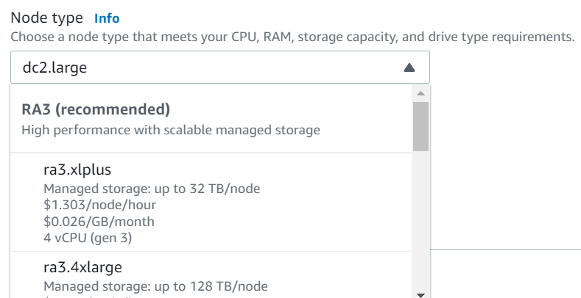
Redshift Service
    Node
      Node type
        RA3: high performance, scalable storage, most expensive
        DC2: high performance, fix volume for SSD storage
        DS2: fix volume for HHD storage
      Nodes must have the same type

Slide 22
Redshift Service
      Leader Node
        Step 1: Receive, analyze & plan query execution for Compute Nodes from Application requests
          Leader Node will distribute queries to Compute Nodes containing the corresponding table
          Can query the Compute Nodes in parallel
        Step 2: it will aggregate the result and return Application
        When saving data, automatically distribute data to Compute Nodes
        Leader node will connect to Compute Node through Internal network
      Compute Node
        Save the data, execute the query and send the results back to the Leader Node
        Max 128 Node, up to 128 TB of space per node
        Support reserved node
        Each node is divided into many Node slices

Slide 23
Redshift Service
    Network
      VPC, subnet
      Enhanced VPC Routing
        By default, data going outside the cluster will go through the internet (Ex: Command COPY, UNLOAD to import/export data to S3, ...)
        If enabled, data going out of the cluster will be routed to an alternate VPC (VPC Endpoint) and using private IP address
        Usecases: Redshift connect to S3 (via VPC gateway endpoint), Redshift connect to RDS, EC2 Instances ssh to Redshift
      Publicly accessible
        Allow User connect to database via the internet (cluster endpoint)

Slide 24
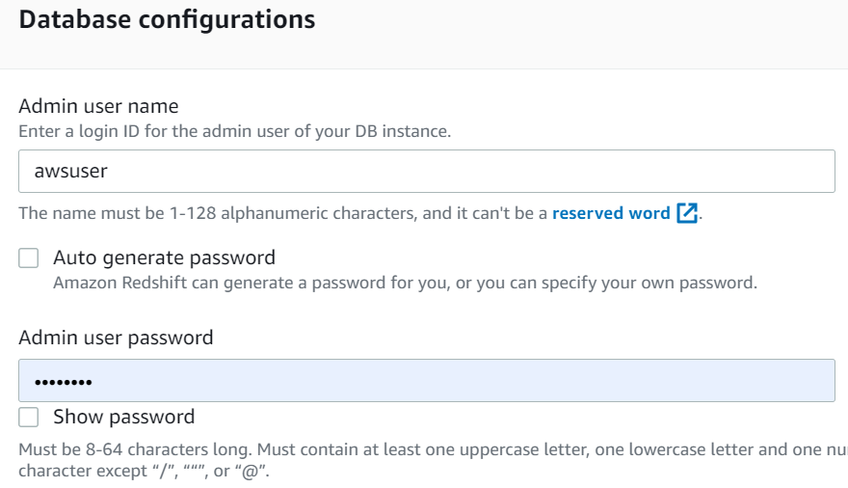
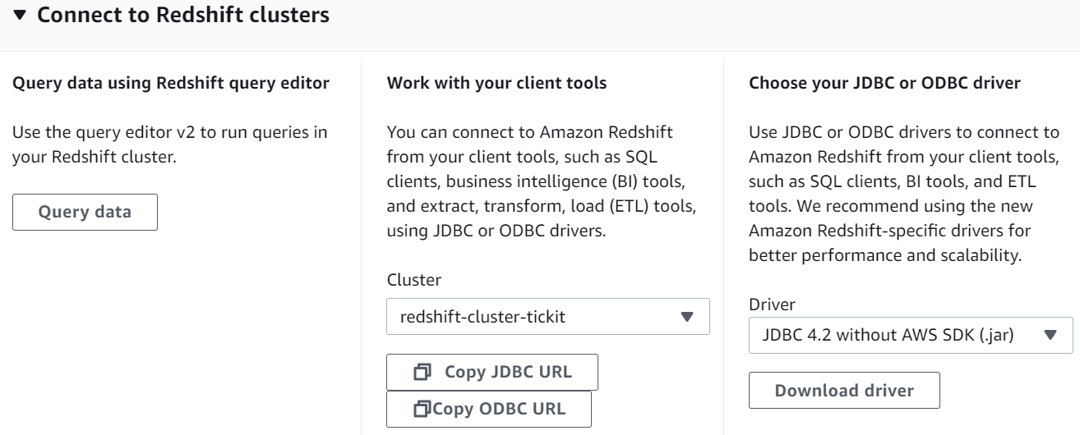
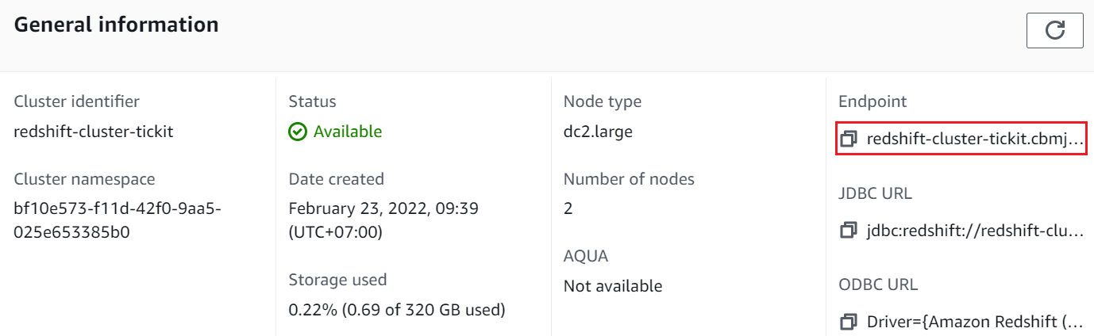
Redshift Service
    Database
      Cluster can contain many databases
      Data is stored in Compute node & encrypted: (in transit, at rest)
      Only support authenticate with Username & Password (Not support IAM)
      Use JDBC/ODBC/Console Editor and Cluster Endpoint & port to connect to Database

Slide 25
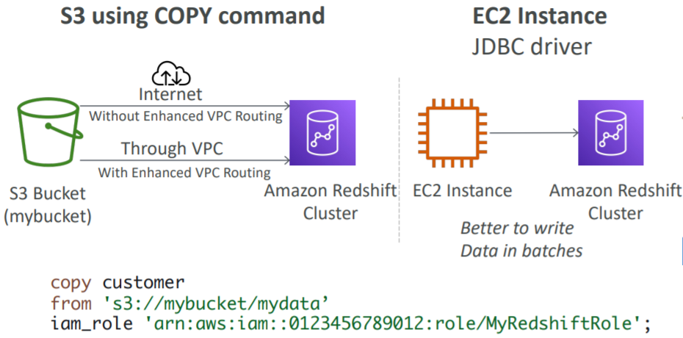
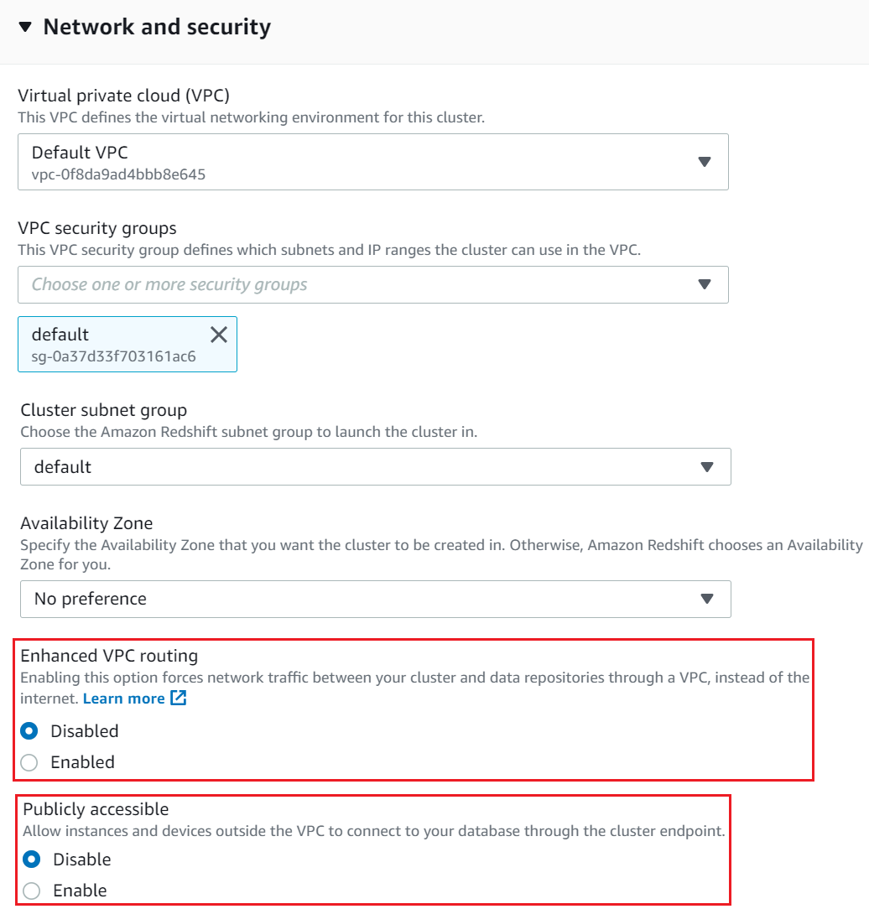
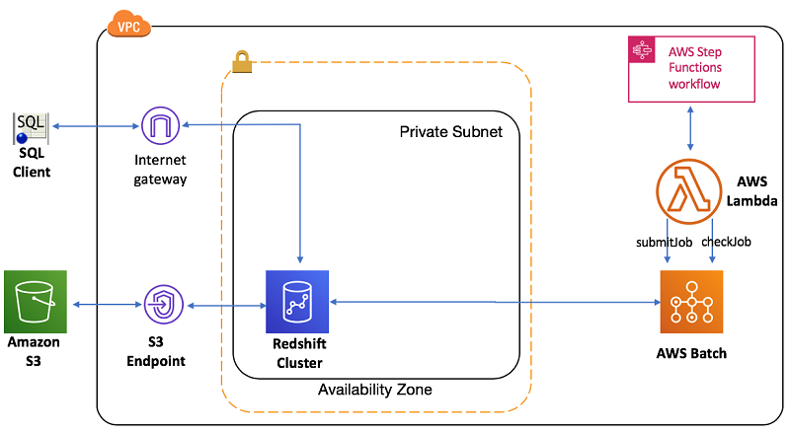
Redshift Service
      Loading data into Redshift
      Enhanced VPC Routing

Slide 26
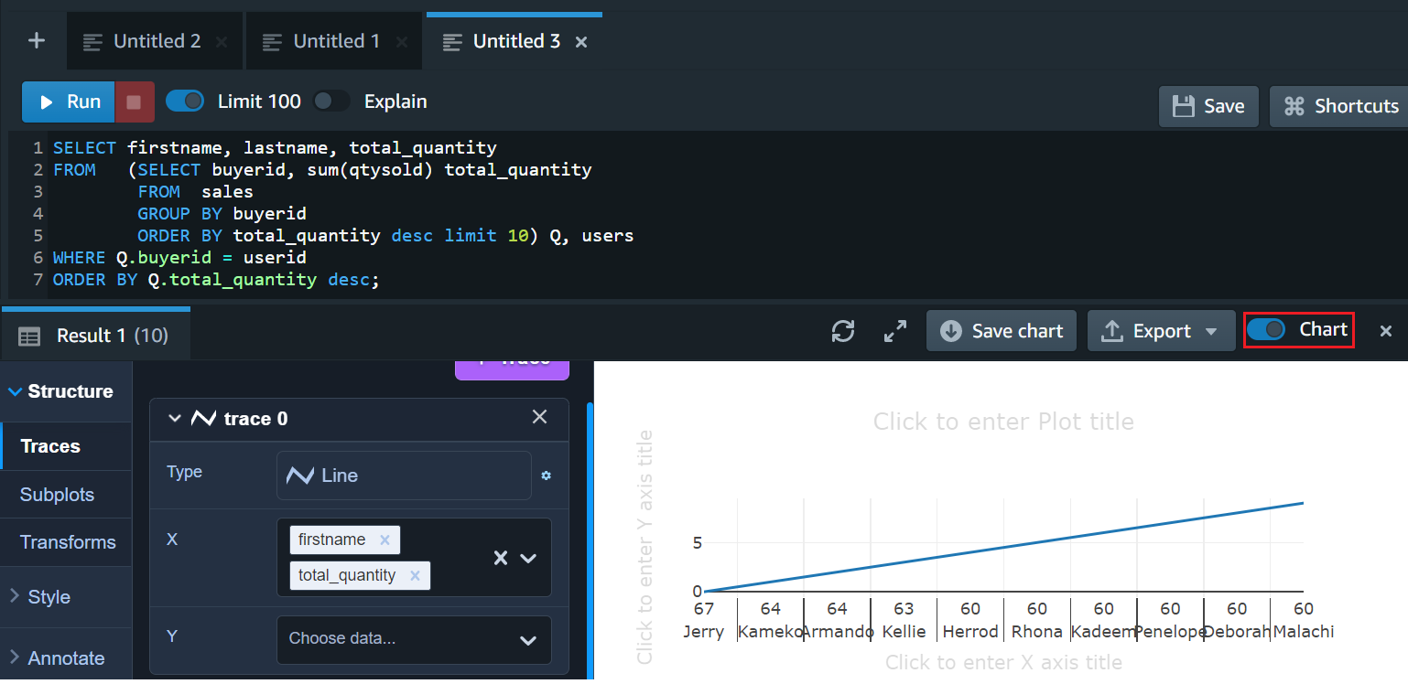
Redshift Service
      Run, save query and run query according to schedule
      You can Query, Create table, View, Store procedure, Function
      Based on PostgreSQL
      You can share database resources to other AWS accounts via IAM Role
      Support Dashboard & chart to checking Cluster & query

Slide 27
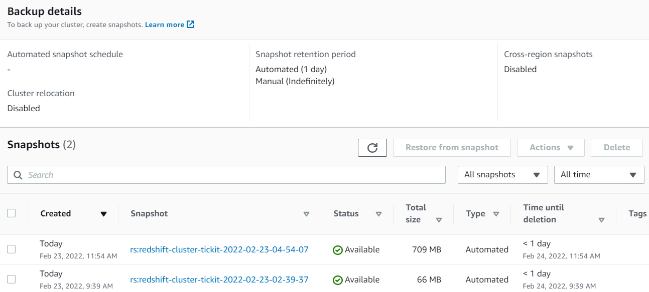
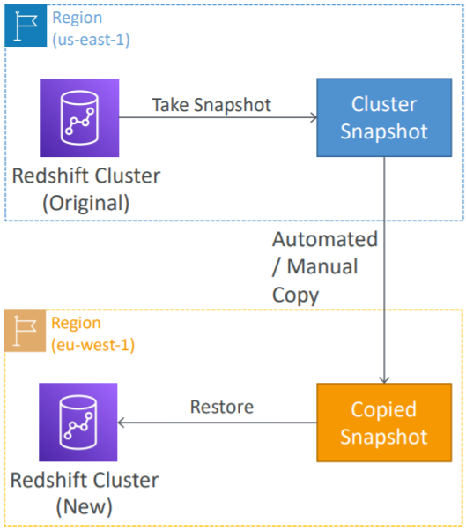
Redshift Service
    You can create schedule to query, resize, pause, resume, reboot cluster
    Config limit usage
    Backup
      S3, incremental, point-in-time
      Automated Backup / Schedule backup / Manual backup
    Monitoring: CloudWatch & Alarm, Database auditing
    Auto healing
      Restore cluster on new region

Slide 28
Assignment
  Self-practice

Slide 29
Redshift Service
Features
  Performance: Massively Parallel Processing, Data compression, Columnar data storage, Query optimizer, Result caching, Compiled code
  Spectrum

Slide 30
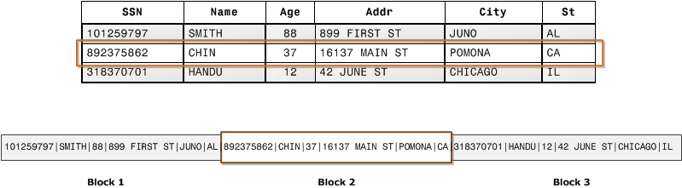
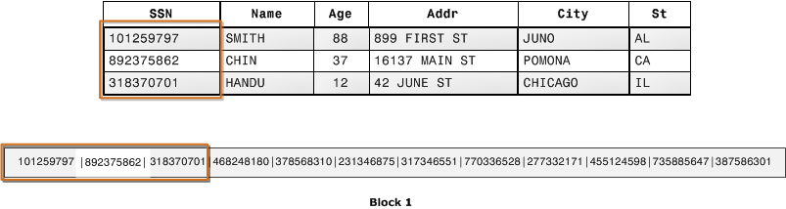
Redshift Service
  Massively Parallel Processing (MPP)
    Can query the Compute Nodes in parallel
  Data compression
    Compress data for faster query (no need to index)
    When querying, data will be compressed into memory (do not decompress to execute the query)
  Columnar data storage
    Use for table to reduce Disk I/O
    Save data by column, not by row
Save by Row
Save by Column

Slide 31
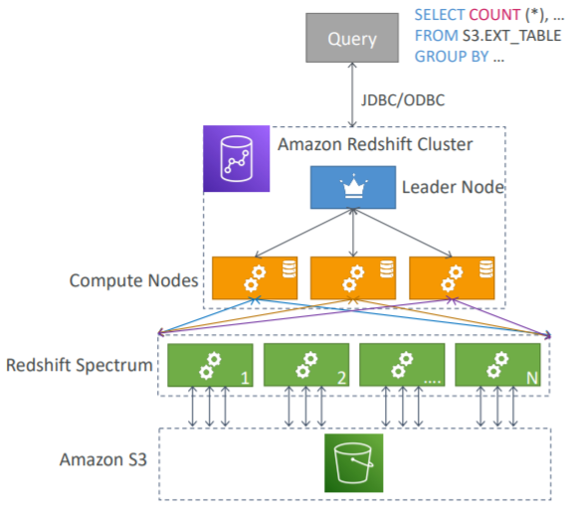
Redshift Service
  Query optimizer
  Result caching
  Compiled code
  Spectrum: Query data that is already in S3 without loading it (no need copy data to Redshift)
  On the other hand, you can copy data from S3, DynamoDB, Remote host (via SSH), DMS, ... to Redshift
Spectrum
Tutorial: Link

Slide 32
Assignment
  Self-practice

Slide 33
Summary
Data Lake
  Is a extreme center data is used to store raw data from many different sources that is not normalized
  Usecases: store raw data, original data (several TBs or more)
Data Warehourse
  Is a center data is used to store normalized data
  The data must be ETL (Extract – Transform – Load) before saving in Data Warehourse
  Usecases: Data analysis, reporting data, Big data

Slide 34
Summary
OLTP (Online Transaction Processing): Use in database, Dynamic data, Statement (insert, update, delete)
OLAP (Online Analytics Processing): Use in Data Warehouse, Static data, Statement (extremely select)
Redshift is service for Data Warehouse, high performance, petabyte-scalable
Based on PostgreSQL, but it’s not used for OLTP
Components
  Cluster
  Nodes: NodeType (RA3/DC2/DS2), Leader Node/Compute Node
  Network: Enhanced VPC Routing, Publicly accessible

Slide 35
Summary
  Database
    Connect via JDBC/ODBC/Console Editor, endpoint & port,
    Based on PostgreSQL
    Query, Create table, View, Store procedure, Function
  Backup: S3, incremental, point-in-time
  Monitoring, auto healing
  Dashboard & chart

Slide 36
Summary
Features
  Performance: Massively Parallel Processing, Data compression, Columnar data storage, Query optimizer, Result caching, Compiled code
  Spectrum
  Share database resources to other AWS accounts via IAM Role

Slide 37
Q & A
Copyright © VTI Academy All Rights Reserved

